Slide 1
Congestion control

Slide 2
When too many packets are present in the subnet, performance degrades, this situation is called congestion
At very high traffic, performance collapses completely and almost no packets are delivered
Congestion control in TCP is based on both open loop and closed-loop mechanisms
TCP uses a congestion window and a congestion policy that avoid congestion and detect

Slide 3
Reasons of Congestion:
Slow Processor
High stream of packets sent from one of the sender
Insufficient memory
Low bandwidth lines
Congestion control and flow control are often confused but both helps reduce congestion

Slide 4
Dividing all algorithms into
open loop
They further divide the open loop algorithms into ones that act at the source versus ones that act at the destination
closed loop
The closed loop algorithms are also divided into two subcategories:
In explicit feedback algorithms, packets are sent back from the point of congestion to warn the source.
In implicit algorithms, the source deduces the existence of congestion by making local observations, such as the time needed for acknowledgements to come back.
The presence of congestion means that the load is (temporarily) greater than the resources can handle

Slide 5
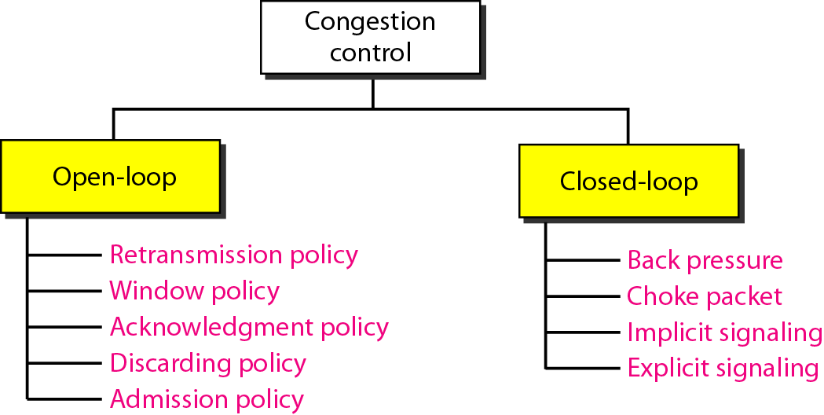
Congestion control categories

Slide 6
Congestion control in TCP
Slow Start
Additive Increase (Congestion Avoidance)
Multiplicative decrease

Slide 7
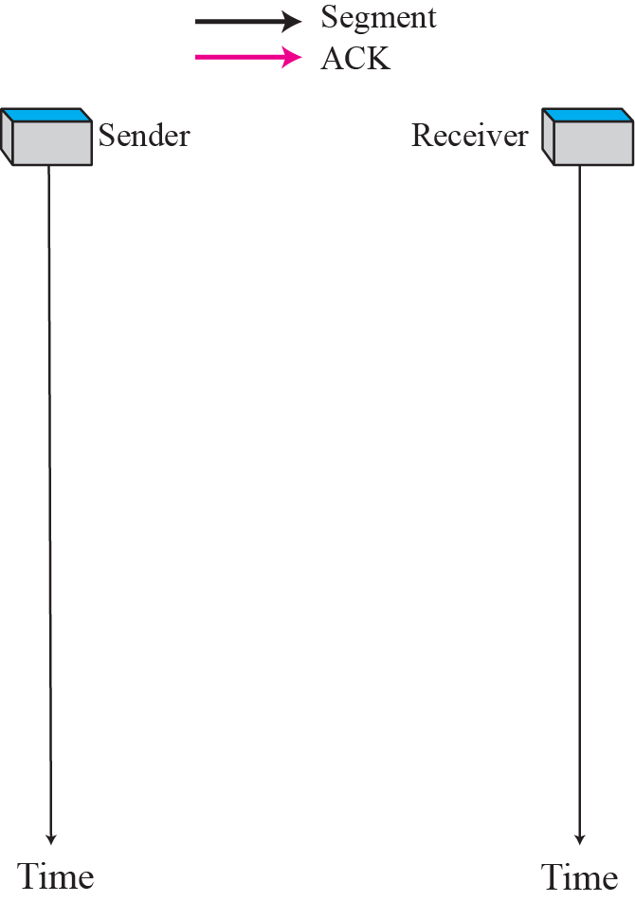

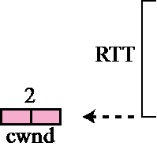
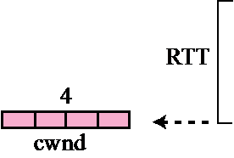
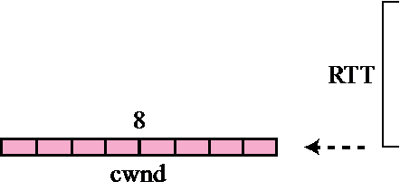
Slow start, exponential increase
In the slow start algorithm, the size of the congestion window increases exponentially until it reaches a threshold.

Slide 8
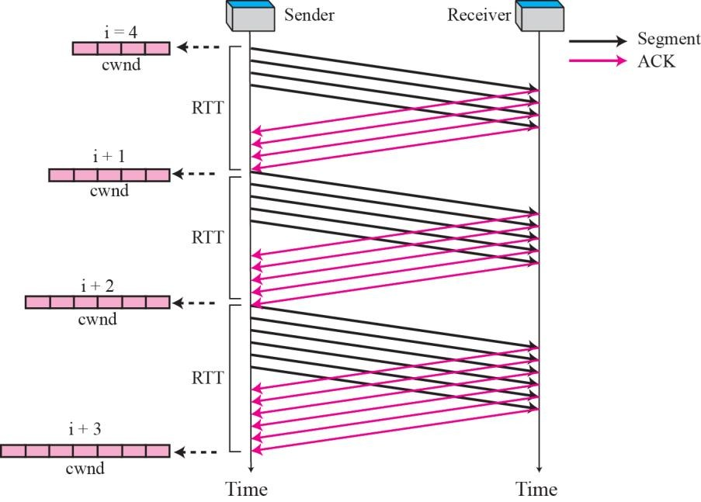
Congestion avoidance, additive increase
In the congestion avoidance algorithm the size of the congestion window increases additively until congestion is detected

Slide 9
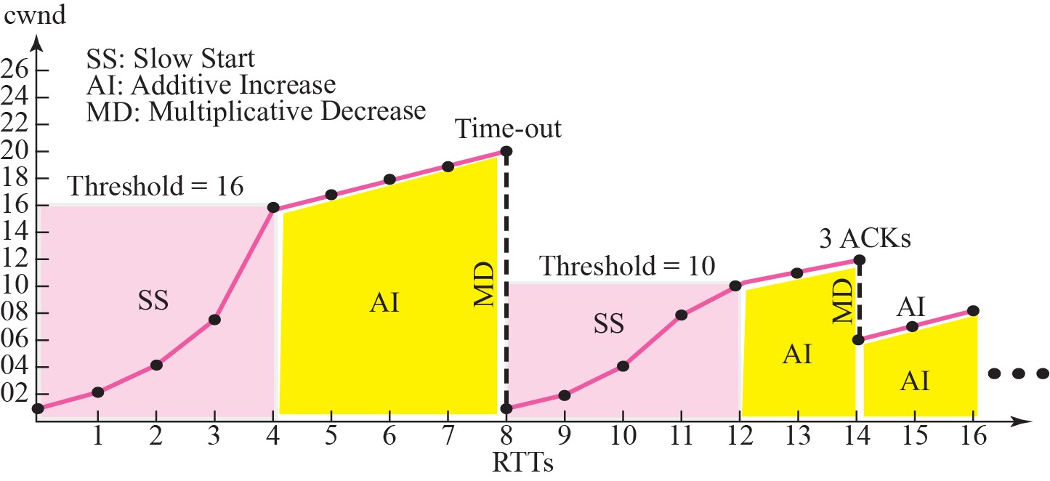
Congestion example

Slide 10
Leaky Bucket (Open loop based)
Leaky bucket is token independent.
If bucket is full packet or data is discarded.
Leaky bucket sends the packets at an average rate.
Leaky bucket does not allow saving a constant rate is maintained.
Packet are transmitted continuously.
It does not save token.

Slide 11
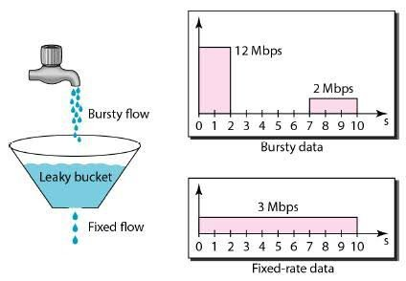

Slide 12
Token Bucket (Open loop based)
Token bucket is token dependent.
If bucket is full, token are discarded but not the packet.
Token bucket allows for large bursts to be sent faster by speeding up the output.
Token bucket allows saving up of tokens (permission) to send large bursts.
Packets can only transmitted when there are enough token.
It saves token.

Slide 13
